Slide 1
Jenkins - Introduction

Slide 2
Build Automation
Build automation is the process of automating the compilation, testing, and deployment of software applications.
It's a key part of modern software development that aims to improve efficiency and streamline the development lifecycle.
Build automation involves:
Retrieving code: Automatically retrieving software code from a repository
Compiling: Compiling the code into a binary artifact
Testing: Running automated functional tests
Publishing: Publishing the software into a shared repository

Slide 3
Build Automation
Build automation can be configured to run with minimal or no interaction from a software developer.
It can be performed at any time, and only requires information stored in the source code control repository.
Some tasks that build automation can perform include:
Compiling source code,
Compressing target files into archives,
Generating software installers, and
Automatically deploying software on a target environment.

Slide 4
Steps
What we do:
Write code: Write the code and commit it to a central repository
Scan code: Use tools to scan the code, such as static analysis
Review code: Start a code review
Compile code: Compile the code and files
Run tests: Run automated testing
Notify contributors: Notify contributors to resolve issues
Generate a build report: Create a build report that details the success or failure of the build process

Slide 5
Concepts
Continuous integration: Automates the build and testing of code every time a team member commits changes to version control
Continuous deployment: Automatically builds, tests, and deploys code on servers
CMake: A tool that generates the directory structures and files needed for any build system
AWS CodeBuild: Automates the process of building code, including compilation, testing, and deployment
Build agent: A program that takes orders from the CI server and starts a build

Slide 6
What is Jenkins?
Jenkins is a self-contained, open source automation server which can be used to automate all sorts of tasks related to building, testing, and delivering or deploying software.
Jenkins can be installed through native system packages, Docker, or even run standalone by any machine with a Java Runtime Environment (JRE) installed.

Slide 7
Why Jenkins?
Master CI/CD Pipelines: Automate building, testing, and deploying code efficiently.
In-Demand DevOps Skill: Jenkins knowledge is valuable for roles like DevOps Engineer and Build Engineer.
Automate Repetitive Tasks: Save time and reduce human error in software development.
Wide Tool Integration: Works with numerous tools like Git, Maven, Docker, and Kubernetes.
Boost Team Collaboration: Facilitates continuous integration and feedback, improving team workflows.
Scalability: Supports large-scale projects with distributed builds.
Career Growth: High demand for Jenkins expertise opens better job opportunities.

Slide 8
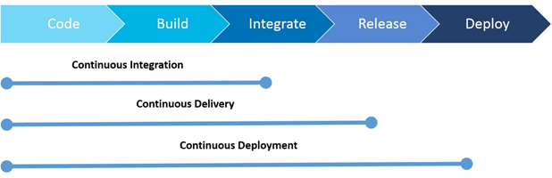
Continous Integration vs Delivery vs Deployment

Slide 9
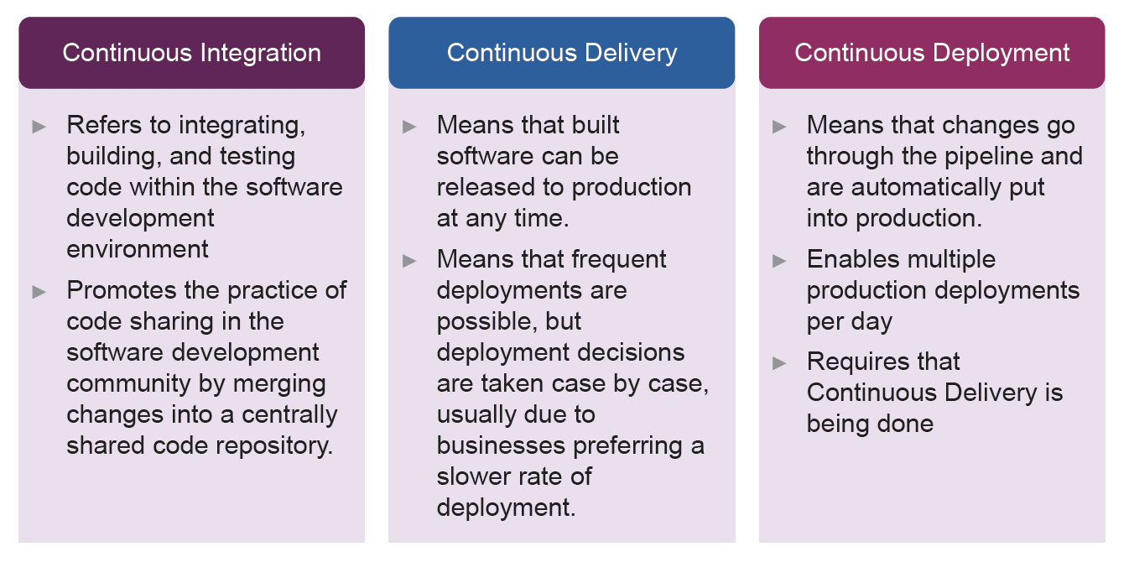
Continous Integration vs Delivery vs Deployment

Slide 10
Creating Jenkins pipeline
A neater way of writing a script to automate the build process.
Continuous delivery pipelines are automated sequences of processes to deliver software from version control to customers and end-users.
A Jenkinsfile is a text file where we define our pipeline as a code.
The Jenkinsfile exists within our project repository.
There are 2 types of JenkinsFile:
Declarative pipeline
Scripted Pipeline
We are going to use the Declarative pipeline.

Slide 11
Creating Jenkins pipeline - contd
An example of such a Declarative pipeline JenkinsFile with 3 stages is shown below:
Build
Test
Deploy
Sample JenkinsFile is given beside.
Keyword
pipeline – keyword, with which every Jenkinsfile must start with.
agent
which Jenkins environment will the entire pipeline or a particular stage will run, examples of agents can be maven, docker, etc.
The agent any means, run the pipeline on any available agent.
stages – consists of one more stage.
stage – a task of our workflow.
steps – It is where we define what to do as part of the task.
pipeline {
agent any
stages {
stage('Build') {
steps {
//
}
}
stage('Test') {
steps {
//
}
}
stage('Deploy') {
steps {
//
}
}
}
}

Slide 12
END

